Slide 1
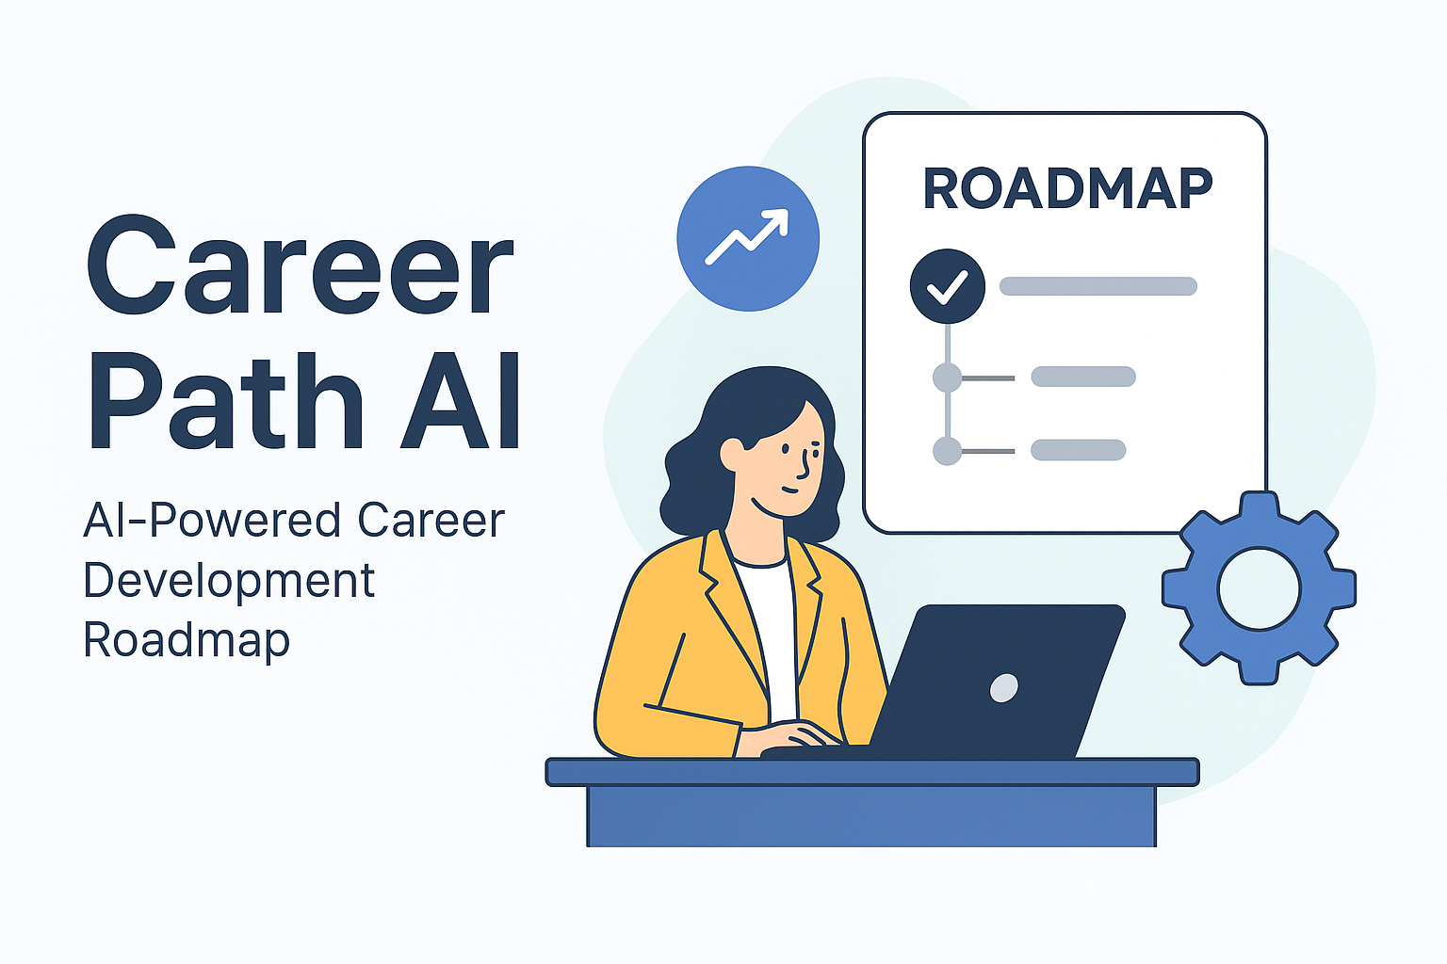
CAREER PATH AI- ROADMAPX Personalized Skill Analysis & Growth Roadmaps

Slide 2
AI INNOVATORS
Simranjeet Kaur
Jasleen Kaur
Jasreet Kaur
Kritika
Ankush Garg
DAV INSTITUTE OF ENGINEERING AND TECHNOLOGY, JALANDHAR

Slide 3
Project Overview
Objective :-Help users identify strengths, weaknesses, and personalized roadmap to reach target career roles.
Key feature:
Resume analysis (PDF)
Skill & experience extraction
Gap analysis against target role
AI-generated personalized roadmap

Slide 4
ABOUT THE PROBLEM STATEMENT
Many professionals struggle to identify skill gaps and career path
Generic training suggestions are ineffective
HR & individuals need a tailored roadmap
Goal: Bridge the gap between current skills and desired career goals .

Slide 5
SOLUTION APPROACH
AI- powered (LLM MODEL USING GEMINI)
INPUTS: Resume , name ,leadership ability ,target role
Resume parsing
Skill mapping & gap analysis
Personalized roadmap generation
OUTPUTS: Strengths, weaknesses, actionable roadmap

Slide 6
SYSTEM ARCHITECTURE
Frontend: React
React is a JavaScript library developed by Facebook (Meta) for building user interfaces (UI), especially web applications.
Backend: FastAPI
FastAPI is a modern Python framework used to build APIs (Application Programming Interfaces) quickly and efficiently.
Call Gemini API → parse resume
Merge with user experience/interest
Gap analysis & roadmap generation
Output: Structured roadmap (JSON + UI display)

Slide 7
DATASET DESIGN
Roles Table
| role_name | required_skills | min_experience | leadership_level |
Resources Table
| resource_type | resource_name | skill_gain |
Users Table
| name | skills | skill_experience | skill_interest |

Slide 8
BACKEND WORKFLOW
Receive resume & user input
Resume parsing using PDF
Merge with user-provided experience/interest
Gap analysis with target role
Generate personalized roadmap using Gemini API
Return JSON for frontend display

Slide 9
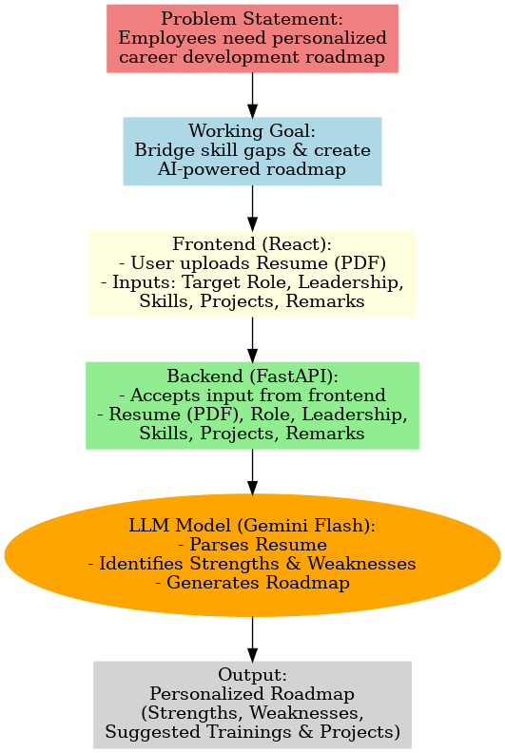
FLOWCHART

Slide 10
TECHNOLOGY STACK
Frontend: React
Backend: Python + Fast API
AI Integration: Gemini API (LLM)

Slide 11
ADVANTAGES
Personalized & actionable roadmap
Automated resume parsing & skill extraction
Tracks user experience & interest
Scalable for multiple users
Human-like guidance using AI

Slide 12
CONCLUSION
Provides personalized AI-driven career roadmaps based on skills, experience, and goals.
Bridges the gap between current abilities and future role requirements.
Helps individuals upskill strategically while enabling organizations to develop future leaders.
Ensures seamless integration between frontend (React), backend (FastAPI), and LLM (Gemini Flash).
Scalable solution that can be extended with progress tracking and advanced analytics.
Contributes to both individual growth and organizational talent development.

